Slide 1
Function of Management
Jahid Hasan
Assistant Professor
Department of IPE,SUST

Slide 2
MANAGEMENT
Management is the attainment of organizational goals in an effective and efficient manner through planning, organizing, staffing, directing and controlling organizational resources.
Organizational resources include men(human beings), money, machines and materials.

Slide 3
Working today
Talent
Technology
Globalization
Ethics
Diversity
Careers
Organizations
What is an organization?
Organizations as systems
Organizational performance
Changing nature of organizations
Managers
What is a manager?
Levels of managers
Types of managers
Managerial performance
Changing nature of managerial work
The Management Process
Functions of Management
Managerial roles and activities
Managerial agendas and networking
Learning How to Manage
Essential managerial skills
Developing managerial potential

Slide 4
Talent
People and their talents are the ultimate foundations of organizational performance
Intellectual capital is the collective brainpower or shared knowledge of a workforce that can be used to create value
A knowledge worker’s mind is a critical asset to employers and adds to the intellectual capital of an organization
Technology
Tech IQ is a person’s ability to use technology to stay informed:
Checking inventory, making a sales transaction, ordering supplies
Telecommuting
Virtual teams
Effective use of online resources
Databases
Job searches
Recruiting
Social Media

Slide 5
Globalization
The worldwide interdependence of resource flows, product markets, and business competition that characterize our economy
Job migration occurs when firms shift jobs from one country to another
Ethics
Code of moral principles that set standards of conduct of what is “good” and “right”
in one’s behavior
Ethical expectations for modern businesses:
Integrity and ethical leadership at all levels
Social responsibility
Sustainability

Slide 6
Careers
Organizations consist of three types of workers, sometimes referred to as a shamrock organization:
Permanent full time workers
Freelance or contract workers
Temporary part-time workers

Slide 7
Free-agent economy
People change jobs more often, and many work on independent contracts
Self-management
Ability to understands oneself, exercise
initiative, accept responsibility, and learn from experience
Organization
A collection of people working together to achieve a common purpose
Organizations provide useful goods and/or services that return value to society and satisfy customer needs

Slide 8
Organizations as open systems interact with their environment

Slide 9
Organizational performance
“Value creation” is a very important notion for organizations
Value is created when an organization’s operations adds value to the original cost of resource inputs
When value creation occurs:
Businesses earn a profit
Nonprofit organizations add wealth to society

Slide 10
Organizational performance
Productivity
An overall measure of the quantity and quality of work performance with resource utilization taken into account
Performance effectiveness
An output measure of task or goal accomplishment
Performance efficiency
An input measure of the resource costs associated with goal accomplishment

Slide 11
Productivity and the dimensions of organizational

Slide 12
Process of Organizing
Determine what is to be done/ Division of Work:
Assign Tasks: Departmentalization:
Link Departments: Hierarchy Development:
Decide how much Authority to Designate/ Authority, Responsibility and Delegation:
Decide the Levels at which Decisions are to be made / Centralization vs. Decentralization:
Decide how to Achieve Coordination:

Slide 13
Techniques for achieving coordination.
Coordination by Rules or Procedures
Coordination by Targets or Goals:
Coordination through the Hierarchy
Coordination through Departmentalization
Using a Staff Assistant for Coordination:
Using a Liaison for Coordination:
Using a Committee for Coordination
Using Independent Integrators for Coordination:
Coordination through Mutual Adjustment:

Slide 14
Manager
Directly supports, activates and is responsible for the work of others
The people who managers help are the ones whose tasks represent the real work of the organization
Levels of management
Board of directors make sure the organization is run right
Top managers are responsible for performance of an organization as a whole or for one of its major parts
Middle managers oversee large departments or divisions
Team leaders supervise non-managerial workers

Slide 15
FUNCTIONS OF MANAGEMENT
PLANNING
ORGANIZING
STAFFING
DIRECTING
CONTROLLING

Slide 16
PLANNING
Planning is determining the objectives and formulating the methods to achieve them. It is more simply said than done.
A job well planned is half done. During planning one needs to ask oneself the following:
What am I trying to accomplish i.e. what is my objective?
What resources do I have and do I need to accomplish the same?
What are the methods and means to achieve the objectives?
Is this the optimal path?

Slide 17
Types of Planning
Purposes or missions,
Objectives-It is the ultimate goal towards which the activities of the organization are directed
Strategies-general program of action and deployment of resources
Policies-general statement or understanding which guide or channel thinking in decision making
Procedures-states a series of related steps or tasks to be performed in a sequential way
Rules-prescribes a course of action and explicitly states what is to be done
Programs-comprehensive plan that includes future use of different resources
Budgets-statement of expected results expressed in numerical terms

Slide 18
Principles of Planning
Take Time to Plan
Planning can be Top to Down or Bottom to Top
Involve and Communicate with all those Concerned
Plans must be Flexible and Dynamic
Evaluate and Revise

Slide 19
Steps in Planning
Determining the goals or objectives for the entire organization.
Making assumptions on various elements of the environment.
To decide the planning period.
Examine alternative courses of actions.
Evaluating the alternatives.
Real point of decision making
To make derivative plans.

Slide 20
STAFFING
Definition 1
Selecting and training individuals for specific job functions, and charging them with the associated responsibilities.
Definition 2
Number of employed personnel in an organization or program. Also called workforce.

Slide 21
DIRECTING/LEADING
Provides positive and dynamic leadership
Provides maximum opportunities
Provides proper motivation of personnel
Ability to command people

Slide 22
CONTROLLING CONCEPTS
Feed Forward Control-Control that attempts to identify and prevent deviations before they occur is called feed forward control, sometimes called preliminary or preventive control.
Concurrent Control-Control that monitors ongoing employee activities during their progress, to ensure they are consistent with quality standards, is called concurrent control.
Feedback Control-In this case, the control takes place after the action. Sometimes called post-action or output control

Slide 23
Steps in the Control Process
Establish Standards of Performance
Measure Actual Performance
Compare Performance to Standards:
Take Corrective Action

Slide 24
Principles of Effective Control
Effective controls are timely.
Control standards should encourage compliance.
Setting effective standards is important
Use management by exception.
Employees should get fast feedback on performance.
Do not over rely on control reports.
Fit the amount of control to the task.

Slide 25
Types of Managerial Decisions:
Programmed
Non programmed.
Mechanistic-It is one that is routine and repetitive in nature
Analytical-It involves a problem with a larger number of decision variables
Judgmental-It involves a problem with a limited number of decision variables, but the outcomes of decision alternatives are unknown
Adaptive-It involves a problem with a large number of decision variables, where outcomes are not predictable

Slide 26
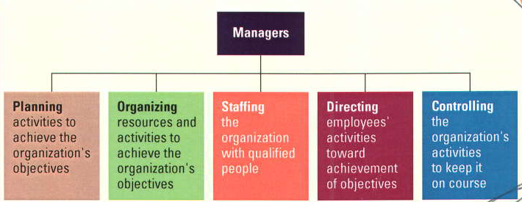

Slide 27
MANAGERIAL SKILLS
TECHNI
CAL
CONCEPTUAL
HUMAN

Slide 28
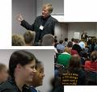
TECHNICAL SKILLS
A persons’ knowledge and ability to make effective use of any process or technique constitutes his technical skills.
For eg: Engineer, accountant, data entry operator, lawyer, doctor etc.

Slide 29
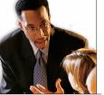
HUMAN SKILLS
An individuals’ ability to cooperate with other members of the organization and work effectively in teams.
For eg: Interpersonal relationships, solving people’s problem and acceptance of other employees.

Slide 30

CONCEPTUAL SKILLS
Ability of an individual to analyze complex situations and to rationally process and interpret available information.
For eg: Idea generation and analytical process of information.

Slide 31
Mintzberg’s 10 Managerial Roles

Slide 32
INTERPERSONAL ROLE
Figurehead- ethical guidelines and the principles of behavior employees are to follow in their dealings with customers and suppliers
Leader- give direct commands and orders to subordinates and make decisions
Liaison-coordinate between different departments and establish alliances between different organizations

Slide 33
INFORMATIONAL ROLE
Monitor- evaluate the performance of managers in different functions
Disseminator-communicate to employees the organization’s vision and purpose
Spokesperson- give a speech to inform the local community about the organization’s future intentions

Slide 34
Katz’s Essential Managerial Skills

Slide 35
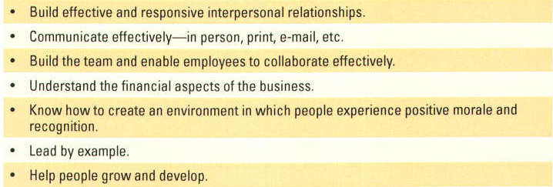
Skills Needed by Managers
Seven Tips for Successful Leadership
Leadership
Technical expertise
Conceptual skills
Analytical skills
Human relations skills
Leadership –
Ability to influence employees to work toward organizational goals.

Slide 36
Autocratic Leaders
Decision makers, “tell” employees
Democratic Leaders
Involve employees in decisions
Free-rein leaders
Employees work without interference

Slide 37
WHAT MAKE MANAGERS SUCCESSFUL?
Hard work
Smart work
Patience
Out of box thinking
Reading and acquiring knowledge
Ethical consciousness
Collaborative relationship
Perseverance

Slide 38
Types of Management
Top Management
President
Chief Executive Officer (CEO)
Chief financial officer (CFO)
Chief operations officer (COO)
Middle Management
Responsible for tactical planning
Implement general guidelines established by top management
First-Line Management
Supervise workers
Oversee daily operations
Directing and controlling primary functions

Slide 39
Management levels in a typical business and non-profit organizations

Slide 40
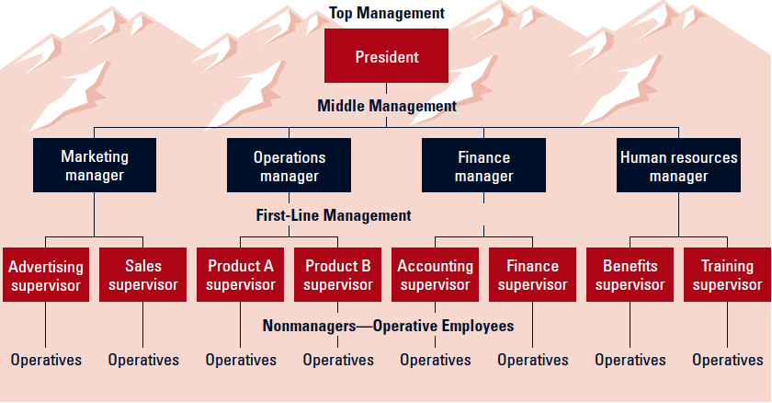

Slide 41
Types of managers
Line managers are responsible for work activities that directly affect organization’s outputs
Staff managers use technical expertise to advise and support the efforts of line workers
Functional managers are responsible for a single area of activity
General managers are responsible for more complex units that include many functional areas
Administrators work in public and nonprofit organizations

Slide 42
Managerial performance and accountability
Accountability is the requirement to show performance results to a supervisor
Effective managers help others achieve high performance and satisfaction at work

Slide 43
Corporate Governance Board of directors hold top management responsible for organizational performance
Financial performance
Ethical performance
Sustainability

Slide 44
Management Process
Managers achieve high performance for their organizations by best utilizing its human and material resources
Management is the process of planning, organizing, leading, and controlling the use of resources to accomplish performance goals
All managers are responsible for the four functions
The functions are carried on continually

Slide 45
Areas of Management
Finance
Production
Operations
Human Resources
Marketing
Administration
Financial Management –
Focus on obtaining money necessary for the successful operations and using funds to further organizational goals.
Production & Operations Management–
Develop & administer activities to transform resources into goods, services, and ideas for the marketplace.
Human Resources Management –
Handle staffing function and deal with employees in a formalized manner
.
Marketing Management –
Responsible for planning, pricing, and promoting products and making them available to customers
Information Technology (IT) Management –
Responsible for implementing, maintaining, and controlling technology applications in business (computer networks)
Administrative Managers –
Manage an entire business or major segment of the business. Coordinate activities of specialized managers

Slide 46
Four functions of management

Slide 47
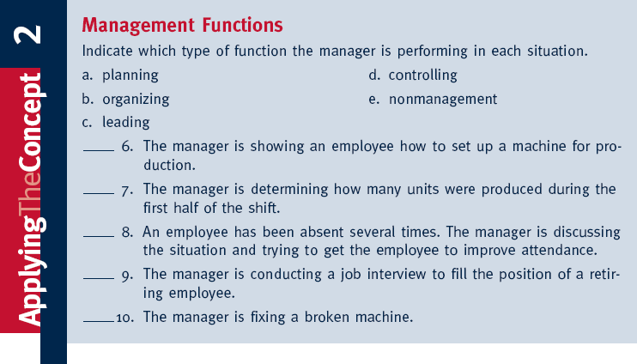

Slide 48
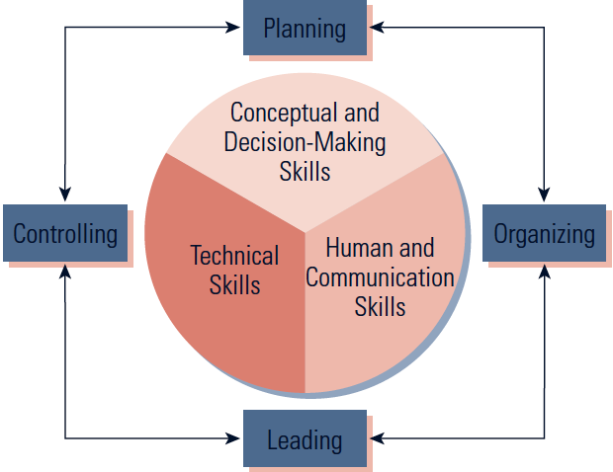
The Systems Relationship among the Management Functions
Management Functions
Management Skills

Slide 49
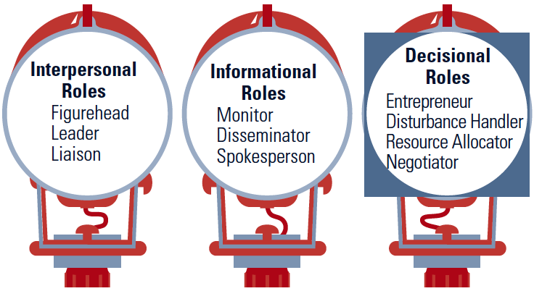
Ten Roles Managers Play
Managers play various roles as necessary while performing their management functions so as to achieve organizational objectives.

Slide 50
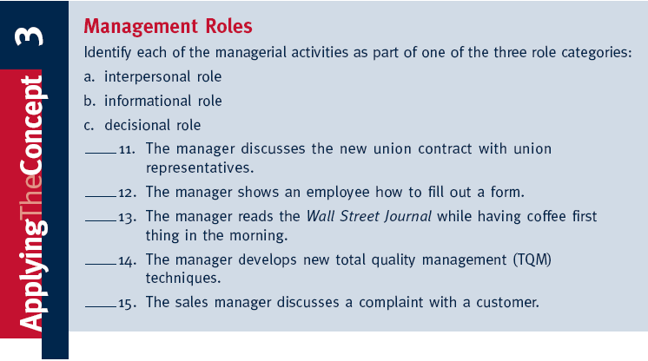

Slide 51
Planning –
Process of determining the organization’s objectives and deciding how to accomplish them
Objectives – results desired by organization
Mission – organization’s purpose and philosophy
Common & Elaborate Organizational Objectives --
Profit, competitive advantage, efficiency, growth
Service, ethics, community responsibility
Plan-
-Strategic Plans
Tactical Plans
Operational Plans

Slide 52
Strategic Plans
Executive level managers
Establish the long-range objectives & overall strategy to fulfill firm’s mission
2-10 years forward-looking
Sustainability
diversification, divestiture , mergers & acquisitions,
Tactical Plans
Short-range – strategy implementation
1 year or less
Environmental change
Periodically reviewed & updated
Operational Plans
Very short-term – actionable, specific
Individuals, work groups, departments
1 month, 1 week, 1 day
Achieve tactical plans
Crisis Management
/Contingency Planning
Focus on potential disasters
Product tampering
Oil spills
Fire, earthquake, terrorist attack
Unethical/illegal employee activity

Slide 53
Organizing –
Structuring of resources & activities to accomplish objectives efficiently & effectively
Importance –
Creates synergy
Establishes lines of authority
Improves communication
Improves competitiveness
Staffing –
Hiring people to carry out the work of the organization.
Importance –
Recruiting
Determine skills
Motivate & train
Compensation levels
Directing –
Motivating and leading employees to achieve organizational objectives.
Motivation
Incentives (raise, promotion)
Employee involvement (cost reduction, customer service, new products)
Recognition and appreciation
Controlling –
Process of evaluating and correcting activities to keep organization on course,
Five Activities –
Measuring performance
Comparing performance against standards
Identifying deviations from standards
Investigating causes of deviations
Taking corrective action

Slide 54
Characteristics of managerial work
long hours
intense pace
fragmented and varied tasks
many communication media
filled with interpersonal relationships
Managerial agendas and networks
Agenda setting
Develops action priorities for accomplishing goals and plans
Networking
Process of creating positive relationships with people who can help advance agendas
Social capital
Capacity to get things done with help
Learning
The change in a behavior that results from experience
Lifelong learning
The process of continuously learning from daily experiences and opportunities

